Slide 1
Changes to Price Adjustment Provisions
Division of Construction Management

Slide 2
Asphalt Binder Index PN 530 and 535

Slide 3
Bid Indices - What we said in 2009.
Bituminous Price Adjustment – Continue Use
Current (2009 & Prior)
C&MS Section 401.20 (Standard Specification Language)
Used in all contracts to adjust the price of liquid asphalt for all asphalt concrete products based on the PG binder type.
Proposed Changes (2010)
Use on multi-season projects only.
Change to a PN from the Standard Specification.
Use a single PG grade as the basis for adjustment, PG 64-22.
Use a single independent reporting source for the index values such as Asphalt Weekly Monitor.
Change the trigger to 10%.

Slide 4
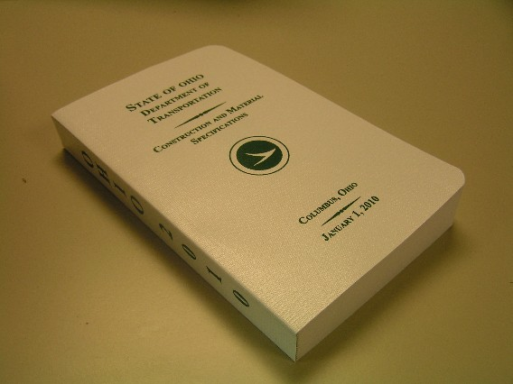
Bituminous Price Adjustment - what we did
Index Changes:
Removed as standard specification 401.20
Using on contract-by-contract basis (PN 530 and PN 535)
Using one binder type for all price adjustments
Using AWM to establish index
Current month’s index available at beginning of next month

Slide 5
Remove from Specifications
Removed specification 401.20 and apply on contract-by-contract basis
Basis - FHWA Guidance TA 5080.3:
Price adjustment clauses should not be standard specifications
Can be applied on a project-by-project basis based on assessment of need

Slide 6
Use One Binder Type
Using one binder grade for index, PG64-22
Basis - Using one index based on one PG binder is the most common method
33 states use only one price adjustment index
Only Alabama determines indexes for all PG binder grades used

Slide 7
Use Published Binder Pricing
Using AWM to establish binder price index
Basis - FHWA Guidance TA 5080.3:
Index must not be “susceptible to manipulation”

Slide 8
Increase Trigger
Increased triggers
15% on single season projects
10% on multi season projects
Basis- FHWA Guidance TA 5080.3:
Price adjustment to be triggered by “significant change”

Slide 9
ODOT Continues to Evaluate HMA Prices

Slide 10
Steel Price Adjustment PN 525

Slide 11
Bid Indices - What we said in 2009.
Steel Price Adjustment – Continue use
Revise the Index Source to more closely reflect steel pricing for products used in transportation projects.
Change Designer Note to reflect use on multi-season projects only

Slide 12
Previous SPA Commodity Table

Slide 13
Steel Price Adjustment – What we did
Reduced the list of eligible steel commodities and revised the index sources:

Slide 14
Steel Price Adjustment – What we did
For Category 1, Table B-1:
The adjustment indices shall determine the BI and MI values for wide flange beams plus a scrap surcharge as listed.
Link: http://www.stld-cci.com/pdf/Price_list.pdf
Link: http://www.gerdauameristeel.com/products/mp/pl.cfm
Link: http://www.nucoryamato.com/
For Category 2, Table B-1:
The Department will post monthly data obtained from the American Metal Market (AMM). The adjustment index (MI, BI) determines the adjustment ratio and the BI determines the raw steel material price for Steel Plate, Cut-to-length as reported for National Mills at the time of bid.

Slide 15
Steel Price Adjustment – What we did
New Designer Note:
For use on all projects expected to be constructed over a time period of more than one year AND that require steel products listed in Table B-1 of the proposal note.
Old Designer Note:
For use on all projects that require steel of the types listed in the note.

Slide 16
Fuel Price Adjustment PN 520

Slide 17
Bid Indices - What we said in 2009.
Fuel Price Adjustment – Continue Use
Change Designer Note to reflect use on multi-season projects only

Slide 18
Fuel Price Adjustment – What we did
Added the following items to the FPA:
Select Granular Backfill, Item 840; 0.75 gal./c.y.
Rigid Bases and Pavements, Item 888; 1 gal./c.y.

Slide 19
Fuel Price Adjustment – What we did
Current Designer Note:
This note is to be used on all projects that contain any of the categories of work listed in Table A-1 of this proposal note. Questions regarding this note should be directed to the Office of Construction Administration at 614-387-2173.
No change to date.
Notes:
All Policies and Standard Procedures available on ODOT Internet Site.

Slide 20
Future Changes

Slide 21
Proposed Index Posting Changes
Index Type | Current Index Cut-off Date | Current Index Effective Month | Proposed Index Cut-off Date | Proposed Index Effective Month | Posting Month
Asphalt PN 530/535 | Last Wednesday of the month (i.e. Jan. 27, 2010) | Month of Index Date (i.e. Jan. 2010) | No change | No change | Month following Index (i.e. Feb. 2010)
Steel (AMM) PN 525 | Last Wednesday of the month (i.e. Jan. 27, 2010) | Month following Index Date (i.e. Feb. 2010) | No change | Change to Month of Index Date (i.e. Jan. 2010) | Month following Index (i.e. Feb. 2010)
Steel (Mill Data) PN 525 | Last Wednesday of the month (i.e. Jan. 27, 2010) | Month of Index Date (i.e. Jan. 2010) | No change | No change | Month following Index (i.e. Feb. 2010)
Fuel PN 520 | Last day of the Month (i.e. Jan. 2010) | Month of Index Date (i.e. Jan. 2010) | No change | No change | Month following Index (i.e. Feb. 2010)

Slide 22
Proposed SPA (PN 525) Changes
Editorial Changes.
Correct the equations as follows
SPA = [(MI/BI) – 0.90] x BI x Q or
SPA = [(MI/BI) – 1.10] x BI x Q
For Category 1, Table B-1:
The Department will post monthly adjustment indices (BI and MI) for wide flange steel beams plus a scrap surcharge using data obtained from the steel producers listed.

Slide 23
Proposed SPA (PN 525) Changes
2) Identification of the steel product subject to adjustment.
a. Documentation package number: PN525 – (Insert the steel product “title” from Table B-1) – (Insert sequential package number beginning with “1”).
Example: PN525 – Steel Piling– 1, PN 525 – Structural Steel – 2, etc…

Slide 24
Proposed SPA (PN 525) Changes
For Category 2, Table B-1:
The Department will post monthly adjustment indices (BI and MI) for steel using data obtained on the last Wednesday of the month from the American Metal Market (AMM), based on the price for Steel Plate, Cut-to-length as reported for National Mills.

Slide 25
Proposed SPA (PN 525) Changes
MI = Mill Shipping Index. - Use the adjustment indices from the month the steel was shipped from the producing mill and properly documented. The adjustment indices will be posted on ODOT’s website.
BI = Bidding Index. - Use the adjustment indices from the month proceeding the month in which the project is bid. The adjustment indices will be posted on ODOT’s website.

Slide 26
Important Points to Note
No new indices planned at this time.
No retroactive application of proposed Index Changes.
All proposed changes are draft.
Use price adjustments as per the contract documents – not the information presented here.
Notes:
All Policies and Standard Procedures available on ODOT Internet Site.

Slide 27
Questions

